Slide 1
ASTRA-sim2.0: Modeling Hierarchical Networks
and Disaggregated Systems for Large-model
Training at Scale
KaiZhuo Yan

Slide 2
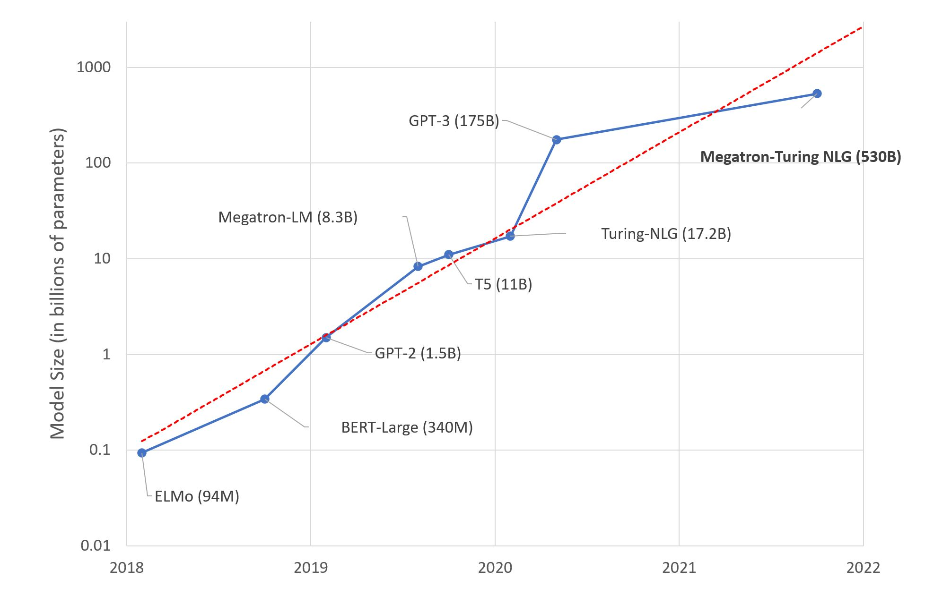
Large Language Models(LLMS)
GPT-3 (175 B)
BERT to GPT-3 requires 1800× more computation to train the model
https://huggingface.co/blog/large-language-models

Slide 3
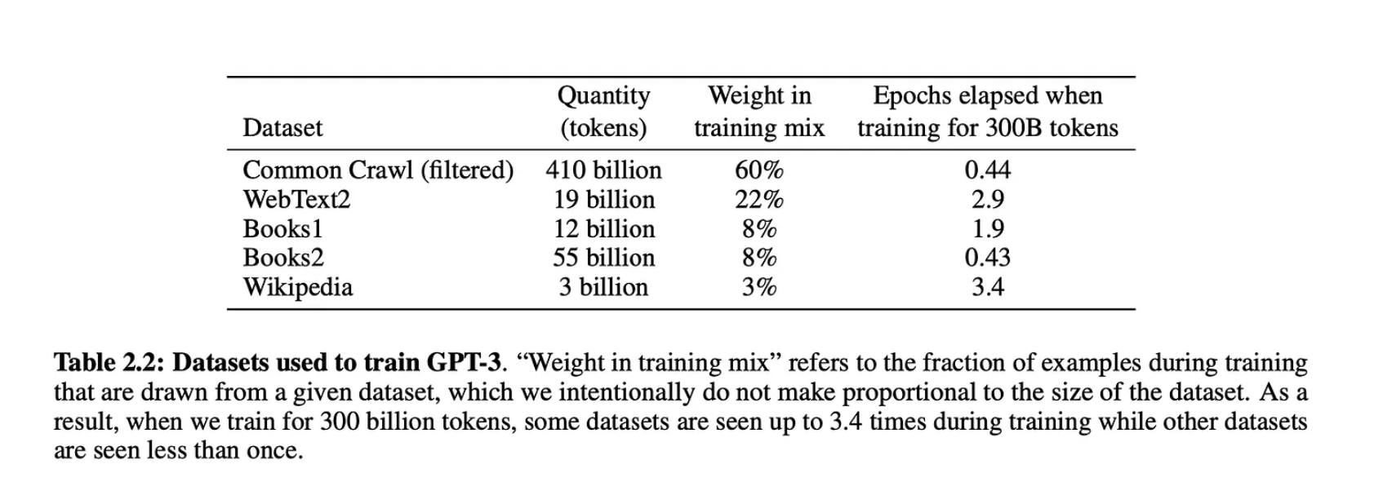
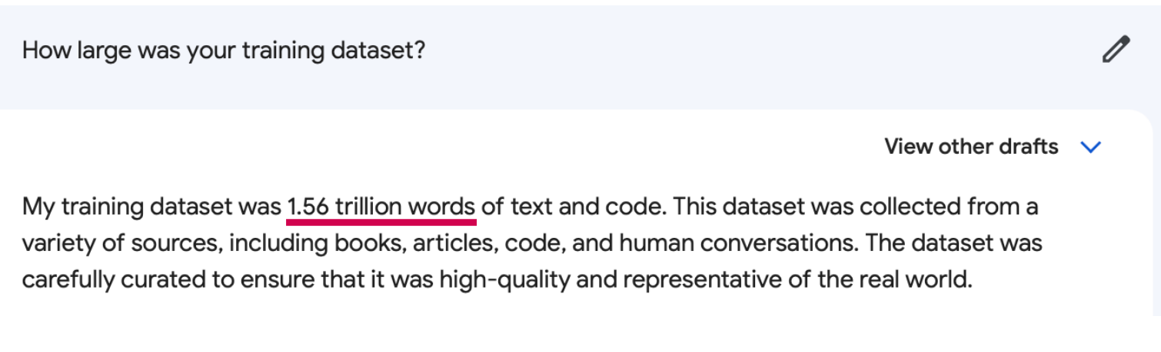
Dataset is also LARGER
570 GB of uncompressed test data
1.56 trillion words
Language Models are Few-Shot Learners

Slide 4
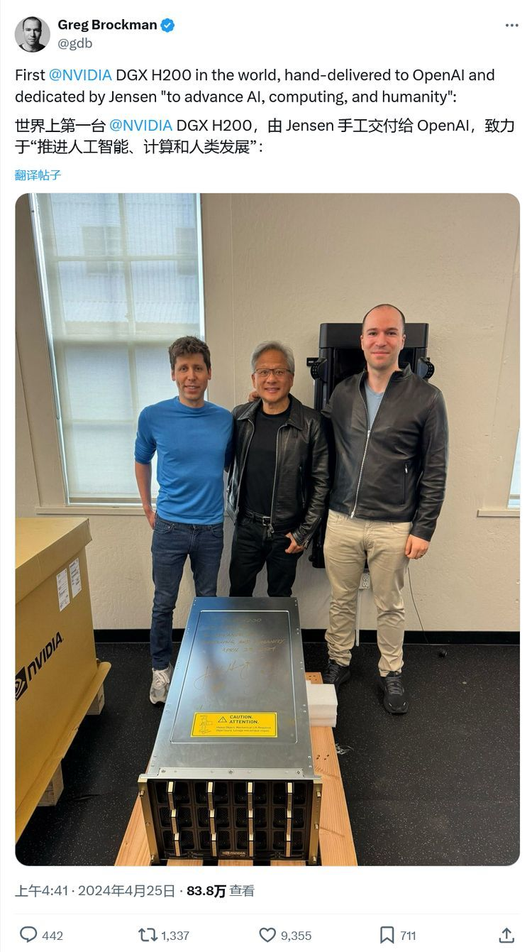
Distributed Training is Necessary
- GPT-3 175B model required 3.14E23 FLOPS of computing for training. Even at theoretical 28 TFLOPS for V100 and lowest 3 year reserved cloud pricing we could find, this will take 355 GPU-years and cost $4.6M for a single training run.
Train GPT-3 using supercomputer cluster consisting of over thousands of GPUs.
https://lambdalabs.com/blog/demystifying-gpt-3

Slide 5
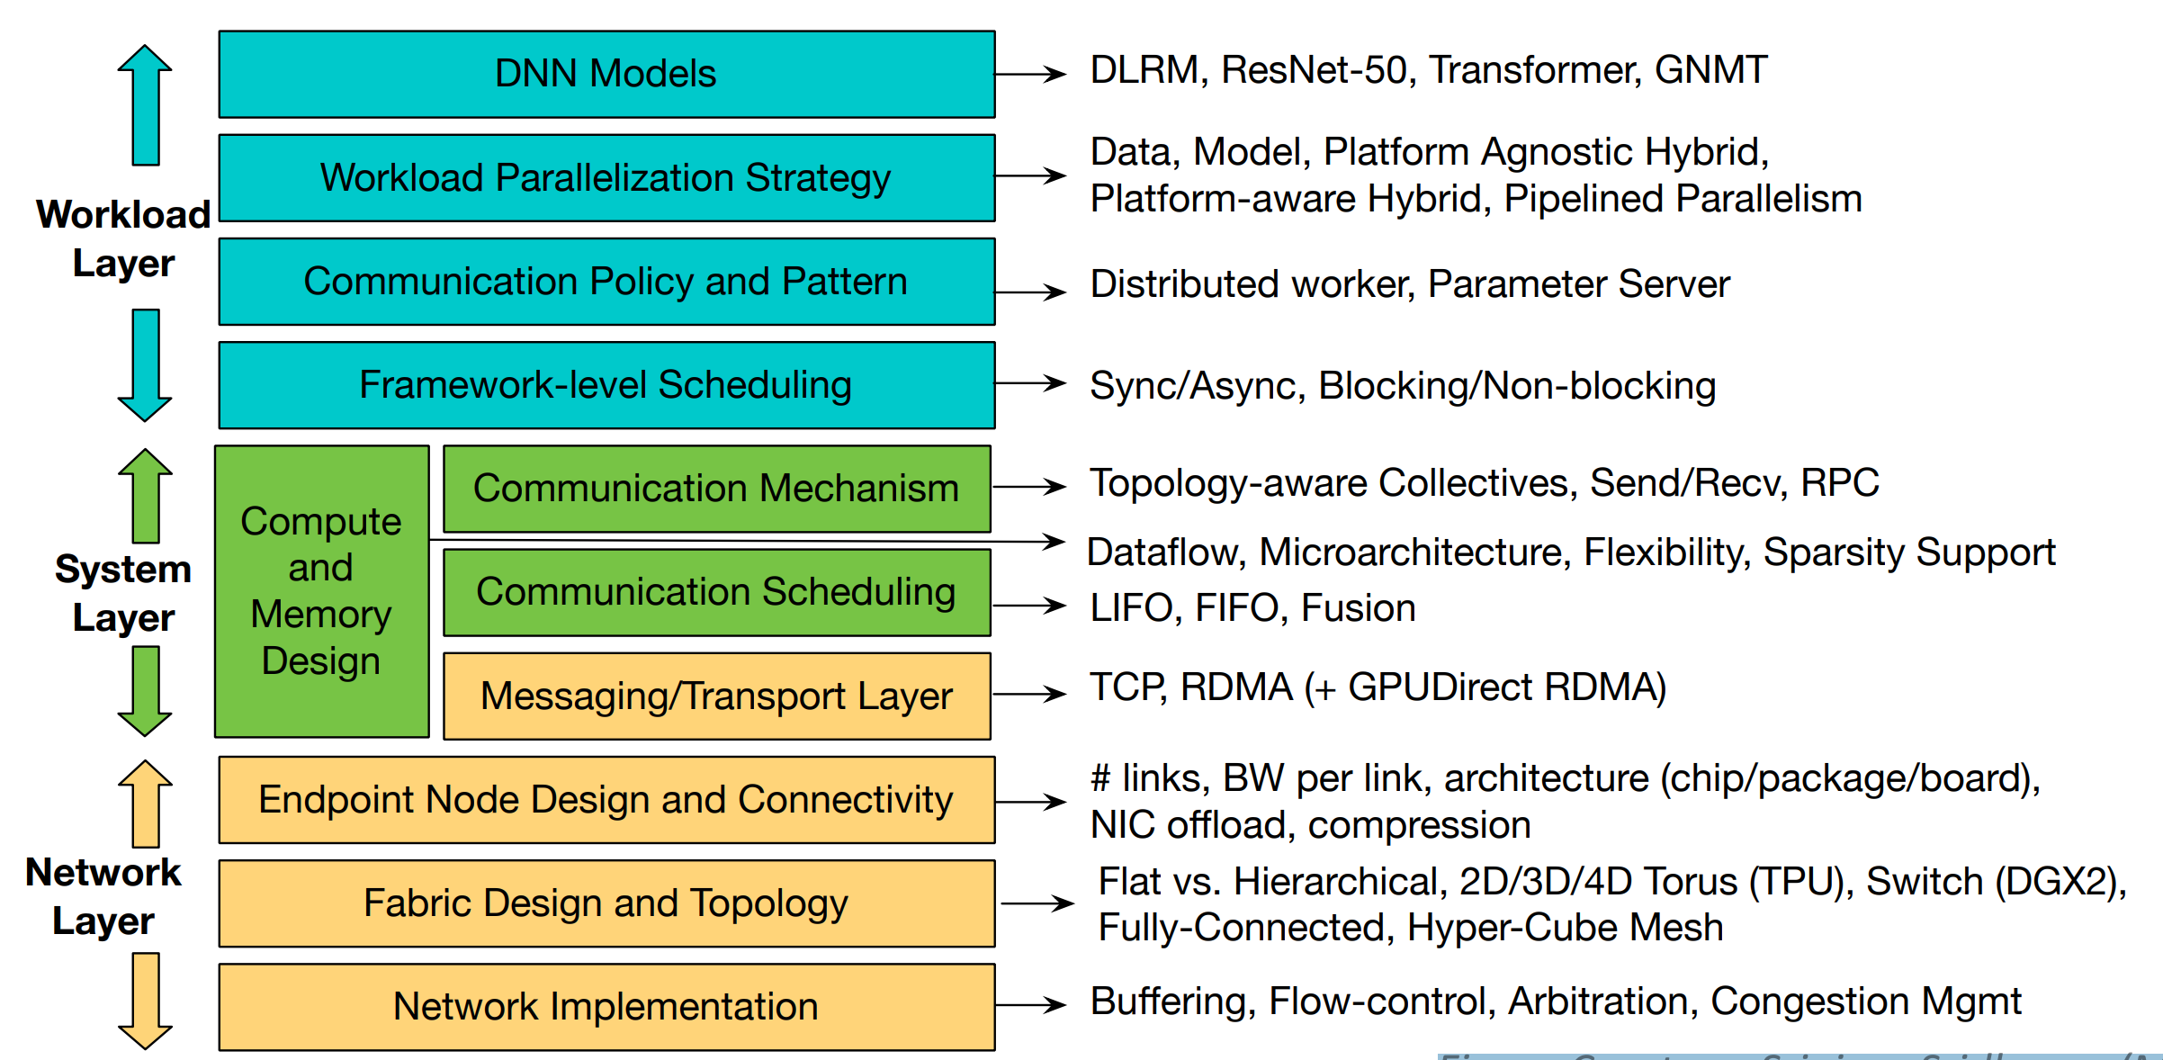
ASTRA-sim:
Aims to model the complete SW/HW codesign stack of distributed training systems.
Workload: Implements the training loop
System: provides various collective communication algorithm implementations (e.g., All-Reduce, All-to-All) and also manages pipelining and scheduling of communication operations.
Network: The HW/SW components of the network and simulates the traffic issues by the system layer.
Figure Courtesy: Srinivas Sridharan (Meta)
SW- software HW- Hardware

Slide 6
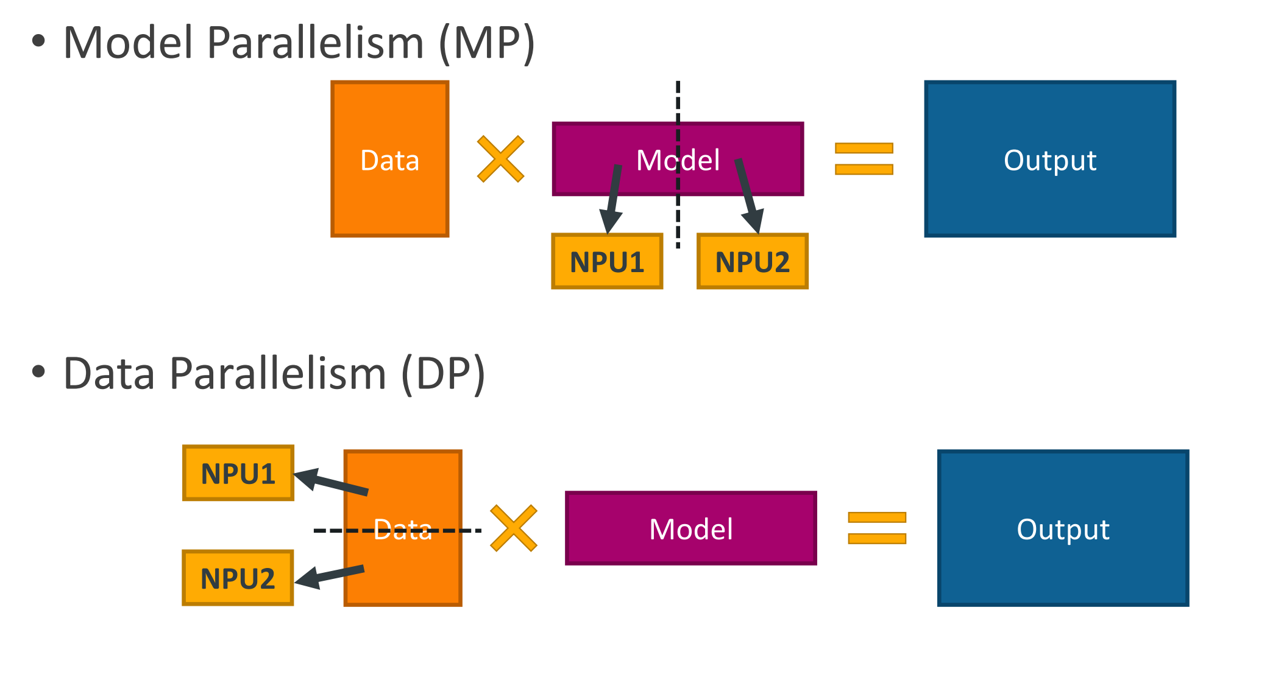
Background – Distributed Training
Parallelization Strategy
Synchronous/Asynchronous Training
Asynchronous: Suffers from the convergence problem and is more complex to implement and maintain.
Synchronous: (Common Approach) All nodes work on their own data and synchronize the distributed information altogether before proceeding to next iteration, usually in the form of collective communications.

Slide 7
Limitation of ASTRA-smi
Limitation Because of time
Ability to model arbitrary parallelisms
Software end, there are new parallelism strategies, like 3D-parallelism, FSDP, and ZeRO, which enable the training of large models, splitting datasets, parameters and optimizer state, while optimizing for communication.
Ability to model multi-dimensional hierarchical networks
New multi-dimensional network topologies with hierarchical bandwidths to interconnect NPUs.
Ability to model memory systems
Computing industry is now building a framework with a new network technology, compute express link (CXL).

Slide 8
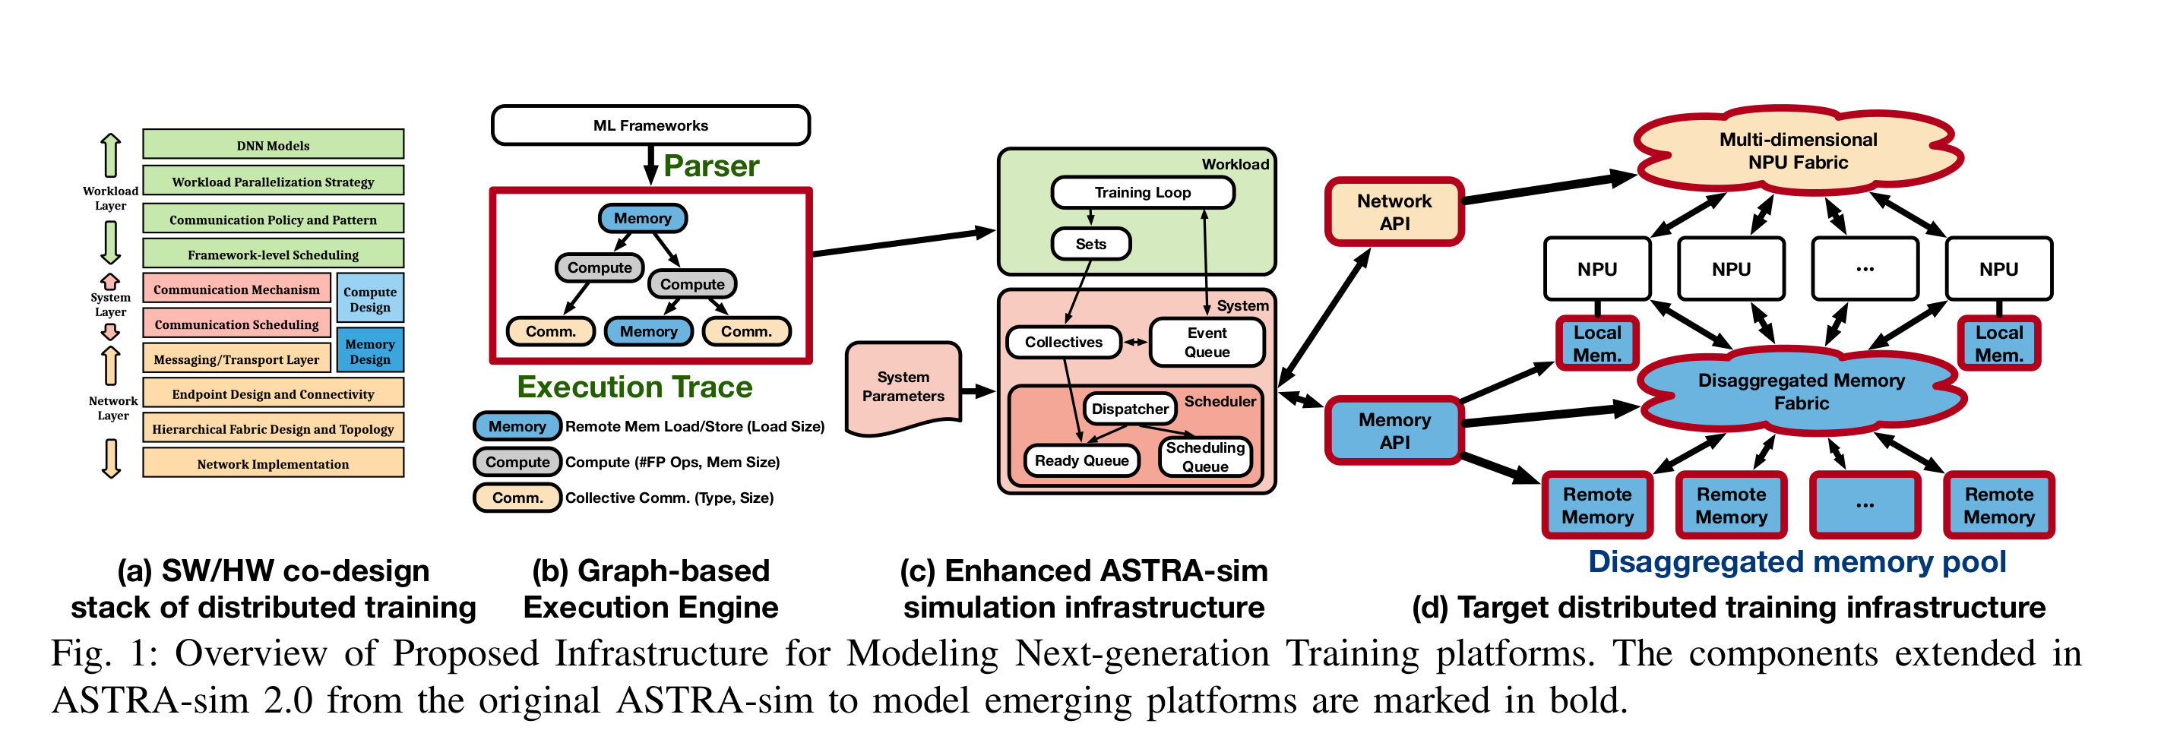
Overview: ASTRA-smi2.0

Slide 9
Ability to model arbitrary parallelisms
Does not support complex parallelization strategies such as pipeline parallelism.
ASTRA-smi assumes that all NPUs perform the same operation at the same time.
It will saves the in implementing data parallelism and model parallelism.
But it does not all pipeline parallelism as it requires executing different operation on each NPUs.
Also, parallelization strategies are tightly coupled with the frontend implementation of ASTRA-sim and implemented as separate training loops in the workload layer.

Slide 10
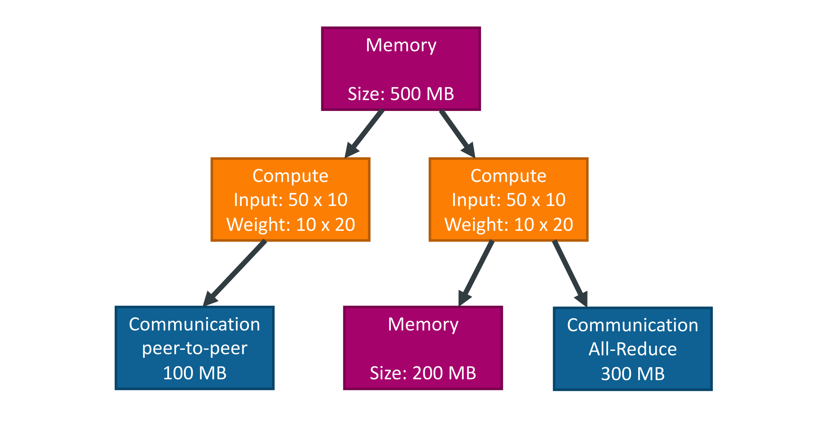
Graph-based Execution Engine
The graph-based execution engine decouples parallelization strategies from the frontend implementation. The graph-based execution engine works on input graphs. The input graphs encode the execution of ML models and their associated parallelization strategies.

Slide 11
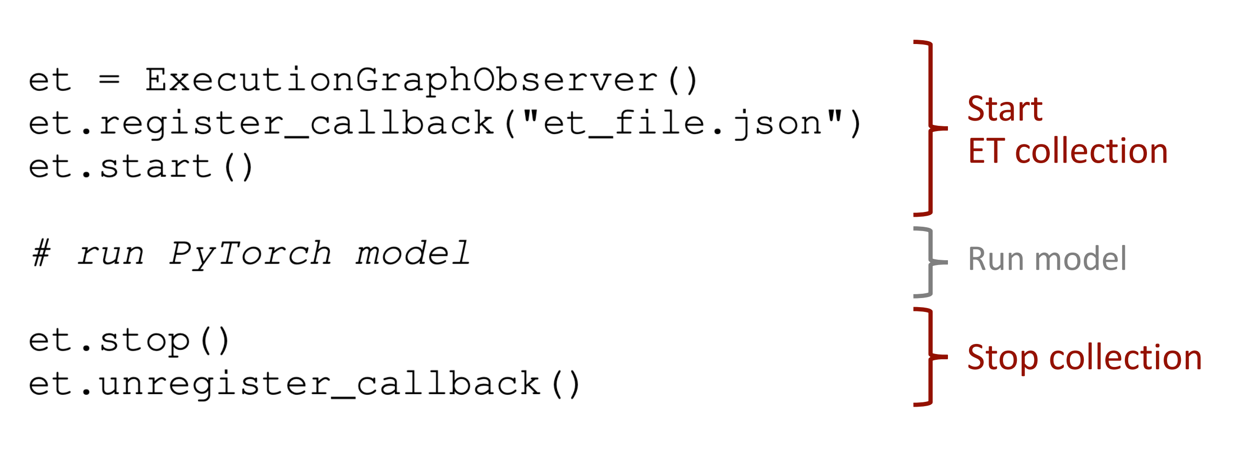
Execution Trace
Pytorch offer an option for collecting such graphs, we call the collected graphs execution traces(ETs)
ETs will feed into the frontend and execution engine which is responsible for simulating a distributed training system.
ETs will include information for simulation such as memory access, computation, and communication.
In ETs, parallelization strategies are encoded with dependencies. As each NPU has an independent graph-based execution engine, each NPU can run different operations.

Slide 12
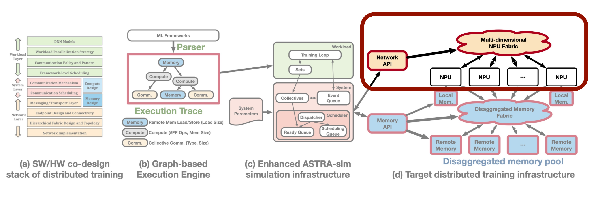
Multi-dimensional Network Modeling

Slide 13
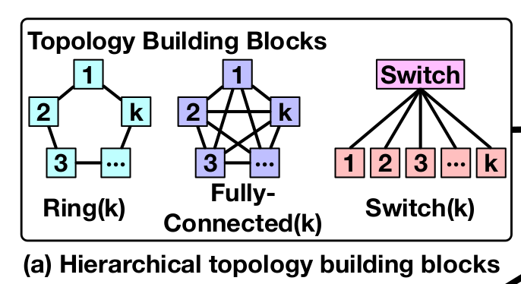
Network Building Blocks
Constructs a multi-dimensional topology by stacking up network building blocks in a hierarchical manner
Ring: Connects k NPU in a ring shape.
Fully-connected: offers all-to-all connectivity among all pairs of NPUs.
Switch: connects all k NPUs using an external switch fabric.
Choose these network building block because they have corresponding well-known topology-aware collective algorithm.

Slide 14
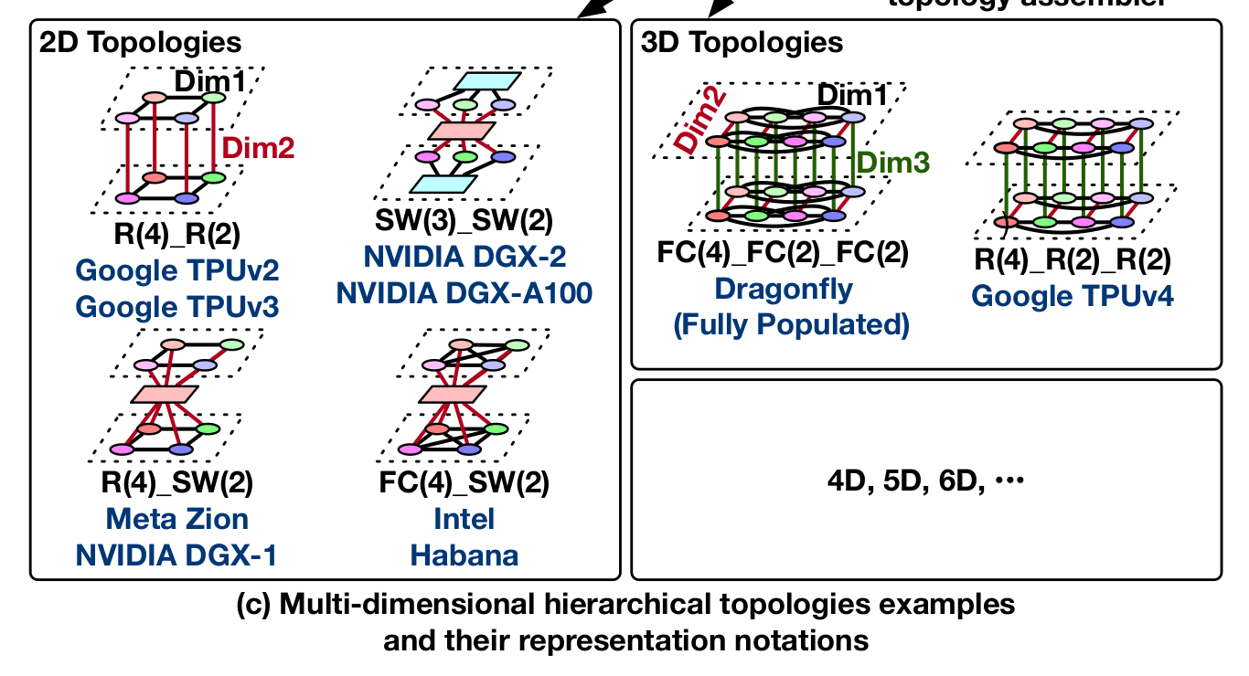
Representing Real Systems
Ring(4)_Ring(2) simply denotes a 2D Torus with 8 NPUs in total, where the first dimension is Ring(4) and two such Dim 1 networks are interconnected using Ring(2) topology.
Ring(4)_Ring(2)_Ring(2) is also shown, where the NPU placement is equivalent but topologies connecting them are substituted to Ring, thereby resulting in a 3D torus instead.

Slide 15
Analytical Network Backend
Implemented a new analytical network backend and ported it to the ASTRA-sim framework.
Need for first-order design-space exploration of the target system at scale. Like topology shape and bandwidth.
Garent is most suitable for modeling network-on-chip targets, it is challenging to easily model arbitrary multi-dimensional network topologies.
Consider the scale (over 1000NPUs !!!)of the state-of-the-art and future system and DL models, cycle-level simulation using Garnet is too slow to be practical.
Multi-dimensional topologies run a topology-aware multirail hierarchical collective algorithm, which does not create any network congestion.

Slide 16
Memory Models
Add a memory API to support various memory models include local memory model and remote memory model and in-switch collective communication.
Memory API takes tensor location, tensor size, memory bandwidth, and memory system design as arguments and returns the number of cycles to load or store a tensor to a memory system.

Slide 17
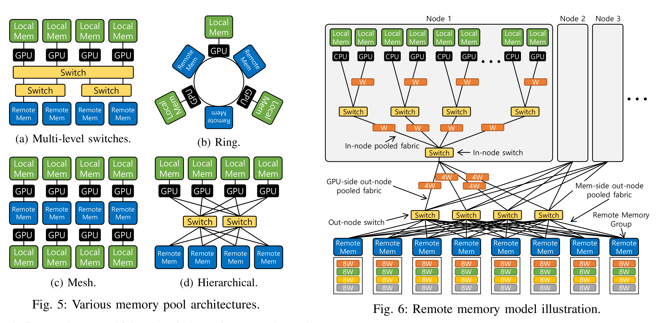
Memory Model
Local Memory Model: simple memory bandwidth model with memory access latency, tensor size, and memory bandwidth.
Remote Memory Model: A disaggregated memory can take any design such as multi-level switches, rings, mesh and hierarchical.
e.g. There are multiple nodes in the system, and each node has multiple pairs of CPU and GPU. CPUs and GPUs are hierarchically connected to out-node switches, and the out-node switches are connected to multiple remote memory groups. Remote memory groups collectively work as a shared memory pool for all CPUs and GPUs. Let's assume that there are 16 nodes with 16 pairs of CPU and GPU in each node. In total, there are 256 CPUs and 256 GPUs. Additionally, we assume that there are four out-node switches and eight remote memory groups.

Slide 18
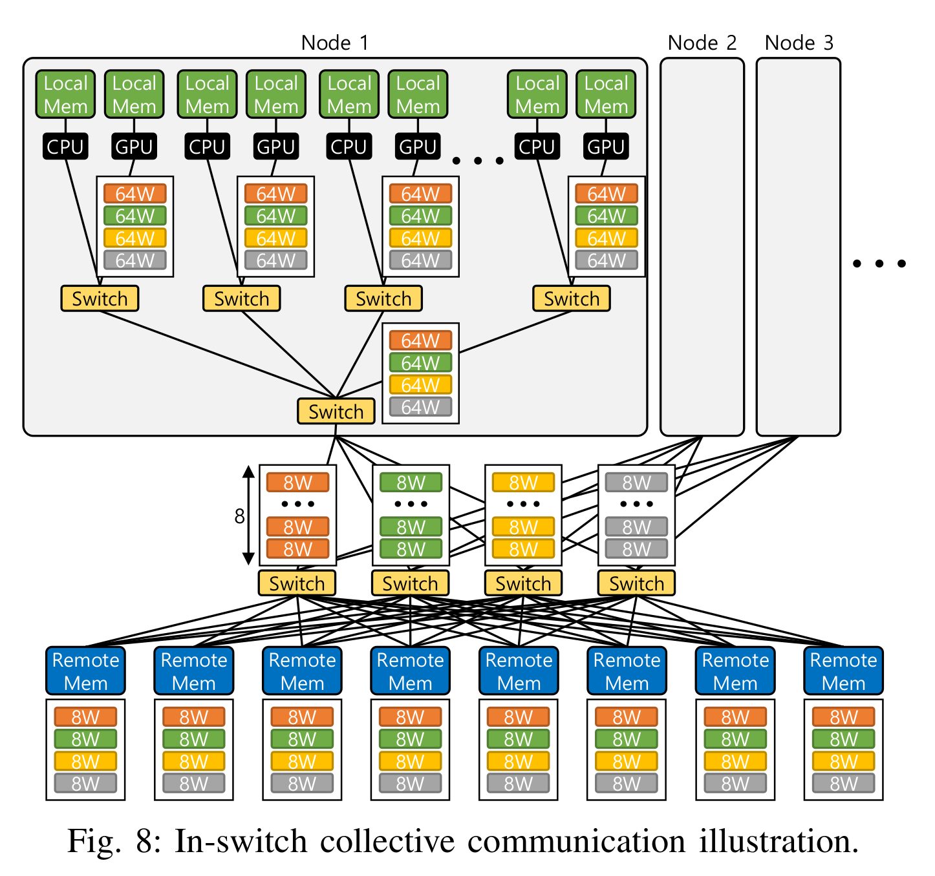
Memory Model
Parameters are gathered while being loaded, and sharded while begin stored. The only different between remote memory access is the data size to transfer for each link as parameters are gathered.

Slide 19
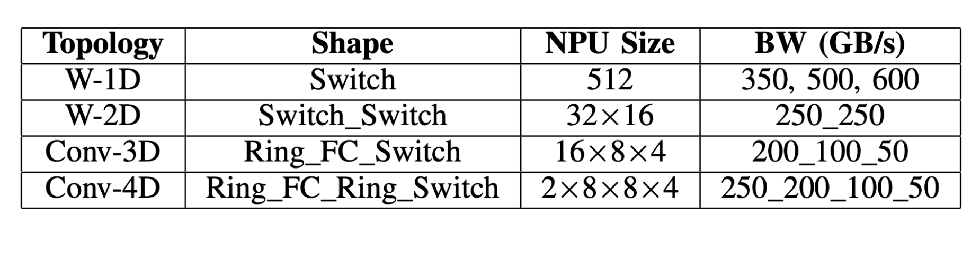
Case Study
Conventional System vs Wafer-scale System
Conventional Systems: multi-dimensional with diminishing BW
3-4D with diminishing network BW with higher network dimension.
Wafer-scale Systems: 1-2D topology with very-high-BW
With very high BW per each Dim

Slide 20
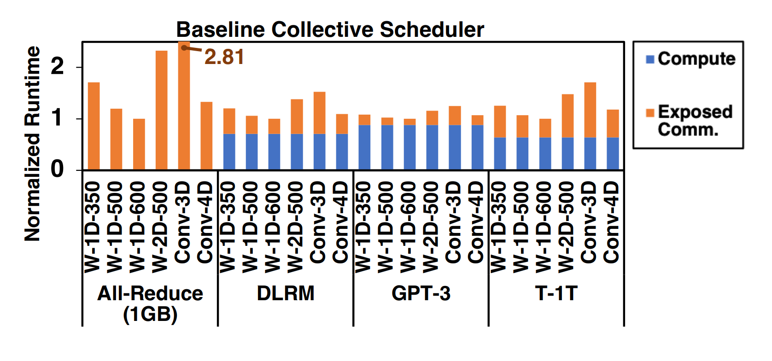
Result
Conv-4D is still powerful
Driving higher BW per NPU

Slide 21
LLMServingSim: A HW/SW Co-Simulation
Infrastructure for LLM Inference Serving at Scale
KaiZhuo Yan

Slide 22
Inefficiencies in current simulation tools
Imagine a scenario where a company like OpenAI or Google is continuously improving its LLM inference infrastructure. Current simulators might require an extensive amount of time to test new hardware accelerators or algorithms, delaying innovation. LLMServingSim drastically cuts this simulation time (by up to 91.5× faster) while maintaining less than 14.7% error rate, enabling faster iterations and quicker deployment of more efficient systems.

Slide 23
Scalability Challenges in Cloud-Based LLM Serving
Consider a situation where multiple company are relying on cloud services to deploy LLMs, like ChatGPT, due to the high costs of building on-premise infrastructure. The massive computational demands make it essential to have scalable hardware solutions. Existing simulators lack the flexibility to model these at scale, especially when heterogeneous accelerators are involved. LLMServingSim enables researchers to explore these designs effectively by allowing plug-ins for different accelerator architectures, improving scalability and resource utilization.

Slide 24
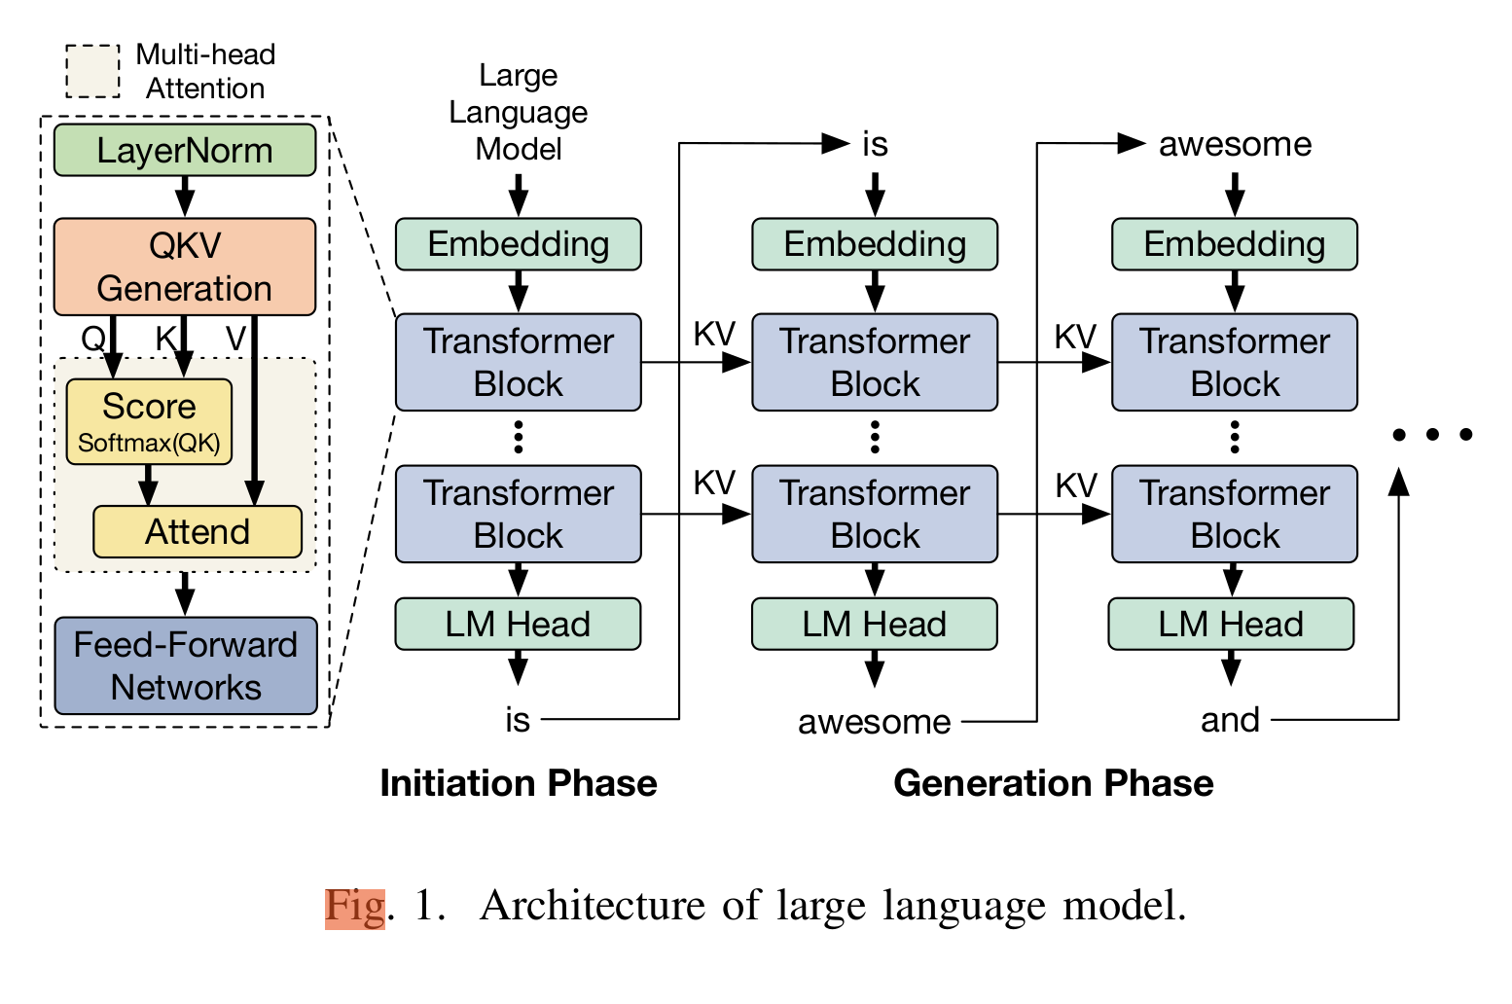
Background – LLM Architecture
Fundamental building blocks: The embedding layer, transformer blocks, and language modeling head.
In the transformer blocks: Query-Key-Value(QKV) generation, multi-head attention, and feedforward network.
Attention is All You Need

Slide 25
Background – Selective batching and iteration-level scheduling
LLM inference serving system often employs batching, which involves grouping multiple requests into a single group.
With Multi-head attention layer make batching difficult.
Need to complete all requests before proceeding to the next batch.
Selective batching: Allow batching in specific layer, like QKV generation. In multi-head attention layers, it allows batch to divided and allocated to multiple worker individually.
Iteration-level scheduling: rescheduling the batch at each iteration, removing completed requests, and adding new ones.

Slide 26
Background – Processing-in-memory (PIM) for LLM
In the generation phase, LLM relies on GEMV operations. Due to lack of matrix reuse it with low arithmetic intensity.
PIM optimizes memory-intensive tasks by reducing data movement through the placement of compute unit in each memory bank. Which utilizes aggregated bandwidth to read intermediate values, execute computation, and send only the results to the host system.
General Matrix-Vector multiplication (GEMV)

Slide 27
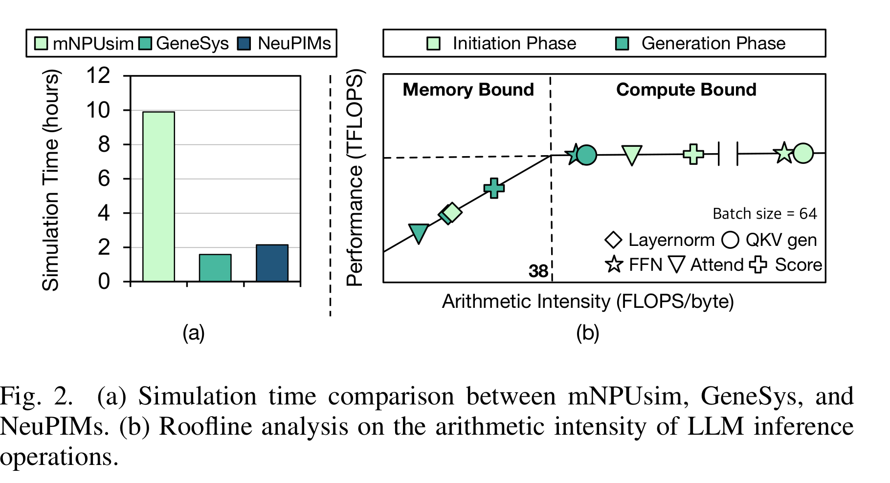
Limitation of existing AI system Simulators
ASTRA-sim focuses on training with repetitive yet identical iterations, which does not align well with the nature of LLM inference serving, where each iteration processes different batches with varying compositions of variable-length prompts.
TOO SLOW: One inference iteration of existing LLM simulators. NPU simulators, nNPUsim and GeneSys, take about 10 and 1.5 hours.
For NeuPIMs, which simulates NPU-PIM hardware, take 2 hours.
Because for fully process requests, multiple iterations are required.

Slide 28
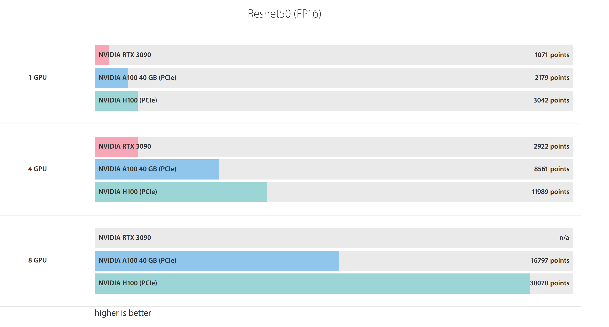
Limitation – Support More Combinations
Requirements for high memory bandwidth, memory capacity, and computation power of LLM inference make it difficult to find "one-fits-all" solution for acceleration.
https://bizon-tech.com/gpu-benchmarks/NVIDIA-RTX-3090-vs-NVIDIA-A100-40-GB-(PCIe)-vs-NVIDIA-H100-(PCIe)/579vs592vs632

Slide 29
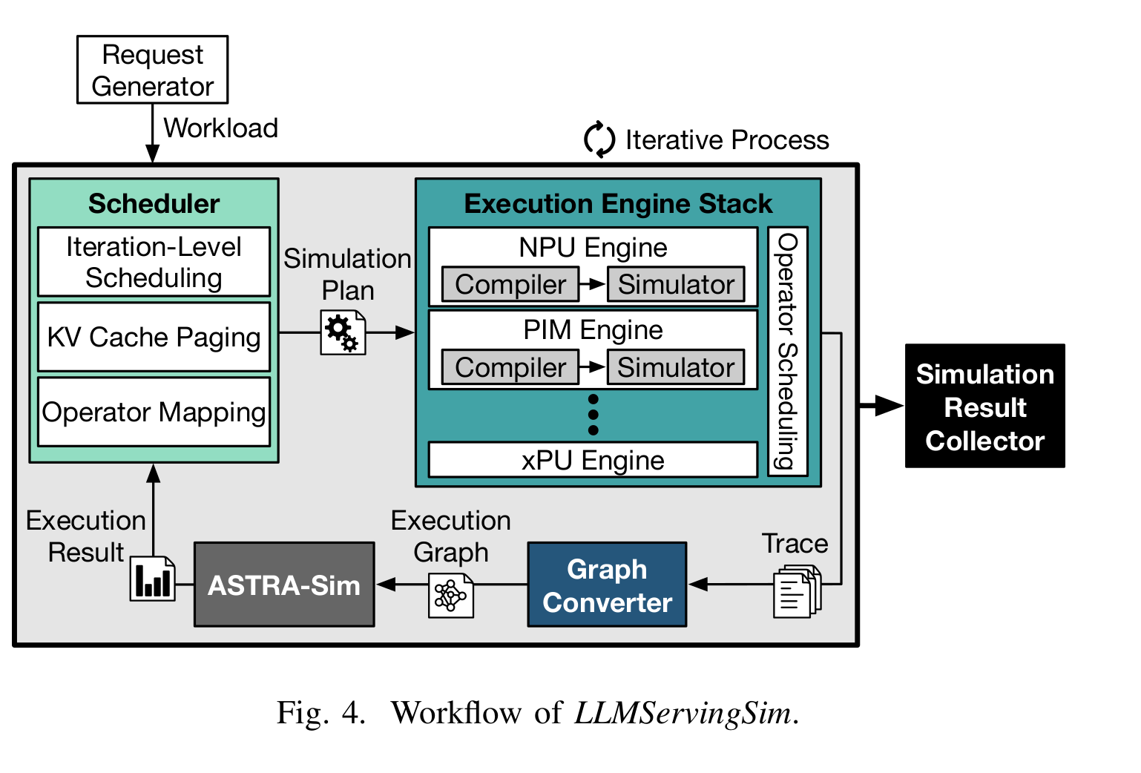
LLMServingSim Overview
Scheduler: receives and organizes user requests into feasible batches based on the scheduling, KV cache management, and operator mapping strategy.
Execution Engine Stack: compiles the model according to the batch configuration created by Scheduler and performs hardware simulation for a single device. It will operators from multi traces and reconstructs them into a single trace.
Graph Converter: Generates execution graph.
ASTRA-sim: takes execution graph represented in graph and performs system simulation and return results back to the scheduler.

Slide 30
LLMServingSim Overview
Receiving Requests
Handling Dynamic Requests
Operator Offloading
Hardware Simulation
Generating Execution Graph
System Simulation by ASTRA-sim
Feedback and Timer Update
Iteration and Progress

Slide 31
Support Parallelism Strategies
Tensor Parallelism, Pipeline Parallelism, Hybrid Parallelism
LLMServingSim can be configured to utilize a specific parallelism strategy by setting the number of accelerator groups according to the system's topology.
Tensor Parallelism: It distributes tensors across the entire nodes and inserts all-reduce operators to the execution graph for intermediate synchronization.
Pipeline Parallelism: It allocated decoder blocks to nodes in sequence, allowing chained computation across them.
Hybrid Parallelism: Combines both parallelism by distributing tensor and layers within and across accelerator groups.

Slide 32
Memory Modeling
Accurate
Batch Reconstruction:
The scheduler checks generated tokens and KV cache size for each batch and conducts batch reconstruction for each iteration.
Assessing Requests:
Scheduler evaluates the length of incoming requests to determine the required number of KV cache pages and allocates them to the local memory of accelerators.
Reassessing After Iteration:
After each iteration, the scheduler reassesses the batch. If sequence length increases due to generated tokens or new requests need to be added, additional pages are allocated on demand.
Handling Memory Shortage:
If there’s insufficient memory for new pages, the scheduler move out the KV cache and the sequence of the last requests to the host memory.
Reloading Evicted Pages:
When memory becomes available, the evicted KV cache blocks are reloaded from host memory for further processing.
Graph Converter’s Role:
The graph converter inserts page eviction and reloading operators into the execution graph, considering the time needed to transfer data between device and host memory.

Slide 33
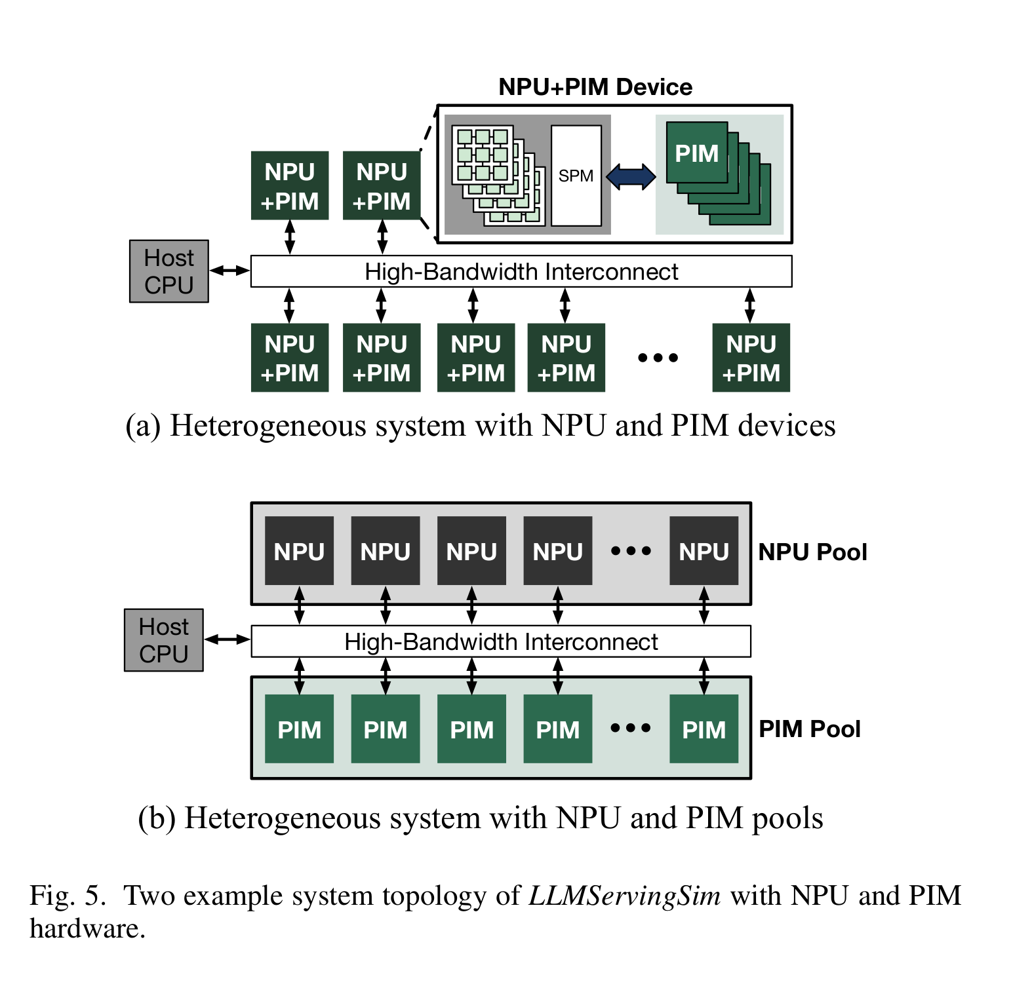
Heterogeneous System
LLMServingSim can flexibly configure the system topology.
One are directly connected, and another one are in the separate pool. For both example systems, accelerator nodes are connected to other accelerator nodes and hosts through high bandwidth interconnects such as CXL.

Slide 34
Operator Mapping
The components that perform operator mapping could be different depending on the
heterogeneous system’s topology and configuration.
In Execution Engine: In a heterogeneous system with NPU and PIM devices, memory-bound operations like Attend and Score are mapped to the PIM module, while compute-bound operations are mapped to the NPU module. Since NPU and PIM devices are directly connected and act as a single node at the system level, the mapping decisions are handled by the internal scheduler within the execution engine in LLMServingSim.

Slide 35
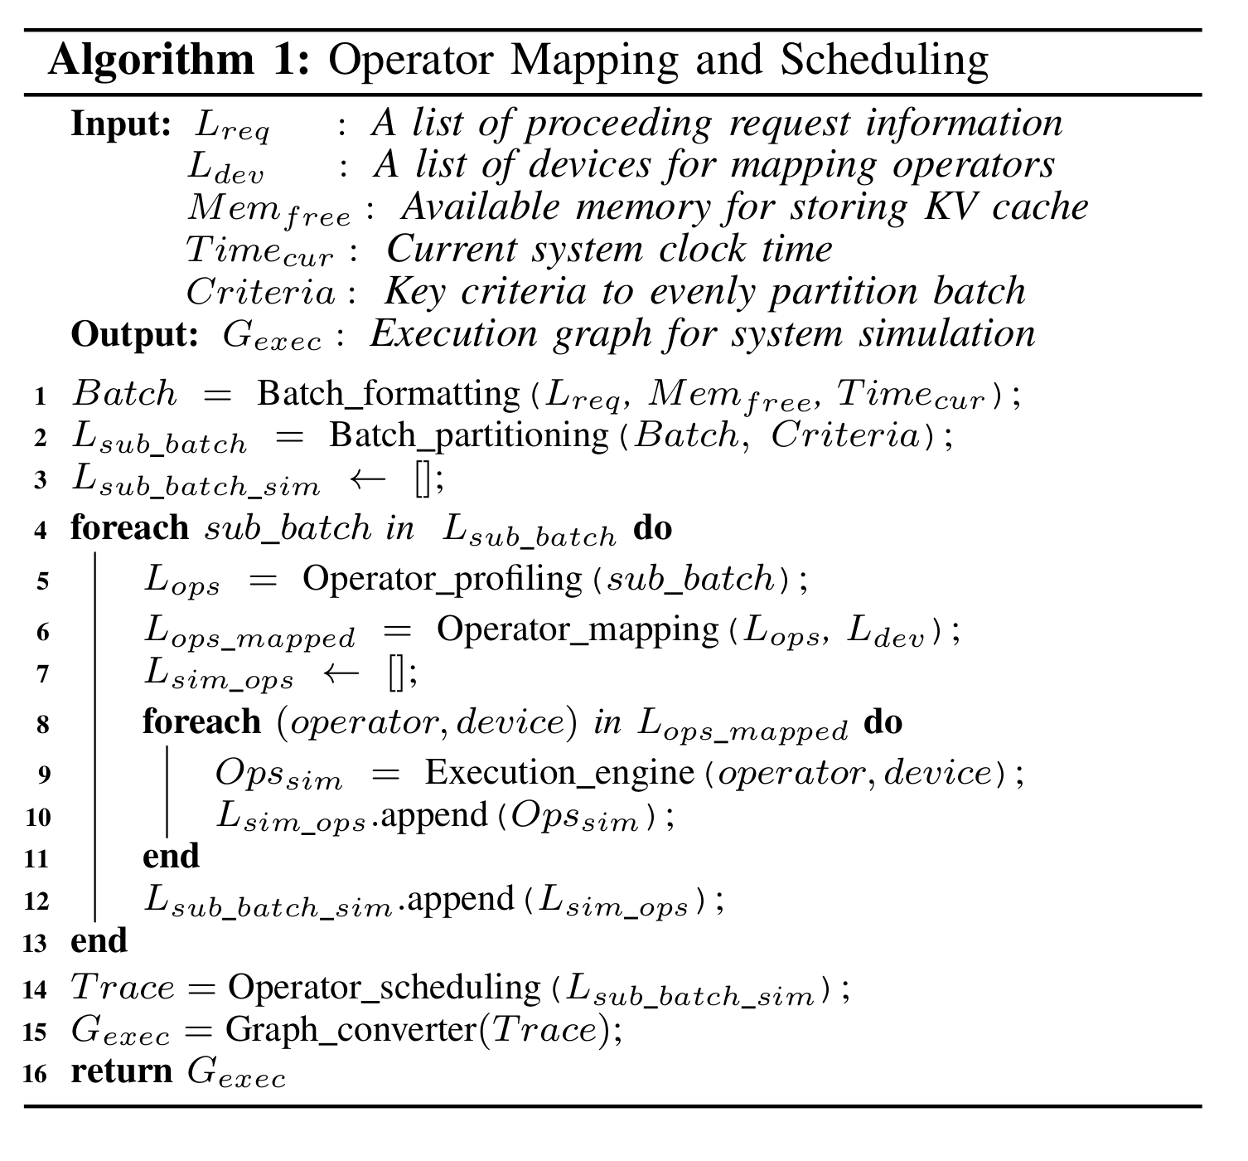
Operator Mapping
In a heterogeneous system with NPU and PIM pools, operator mapping is handled by both the scheduler and the graph converter. (In line 6)The scheduler determines which operator is mapped to which device based on the operator's characteristics and hardware, then creates simulation plans accordingly. For memory-bound operations, the scheduler assigns them to the PIM execution engine, while compute-bound operations are assigned to the NPU execution engine. The execution engines then simulate these plans and generate traces, which are used by the graph converter in LLMServingSim.

Slide 36
Operator Mapping
(In line 15)The LLMServingSim graph converter transforms output traces into an execution graph by embedding the compute node type and ID for each operator, enabling accurate simulation based on the mapping. It also inserts data transfer operators to handle intermediate results between accelerator pools. For example, in a system where NPU and PIM pools are connected via high-bandwidth interconnects, data transfer operators are added before and after the GEMV operation in the PIM pool. Operator mapping is independent of the parallelism strategy, allowing for different topologies and parallelism methods in each accelerator pool.

Slide 37
Operator Scheduling
To optimize the use of heterogeneous accelerators, the LLMServingSim scheduler performs batch partitioning (line 2), splitting request batches into independent sub-batches to allow overlapping execution across accelerators while ensuring fairness in computation and memory access. After operator mapping, each execution engine compiles and simulates the operators, generating traces. (Line 14) the operator scheduler uses a greedy to determine the execution order, considering dependencies between operators and accelerator availability. This approach maximizes hardware utilization by overlapping operators and sub-batches.

Slide 38
Fast Simulation
LLMServingSim introduces result-reusing techniques to reduce compile and simulation time by minimizing computation redundancy. First, through model redundancy reuse, it compiles one transformer block and replicates it, significantly reducing overall compile time. It also separates attention layers from non-attention layers, compiling the latter only once and swapping the attention layers as needed. Second, computation reuse is achieved by caching previously simulated results. Non-attention layers, which take longer to process, are cached and reused frequently, while attention layers, though requiring more frequent simulation, are quicker to process. This strategy effectively reduces overall simulation time.

Slide 39
Evaluation - Setup
For the validation and evaluation of LLMServingSim, both a homogeneous NPU system and a heterogeneous NPU-PIM system are used. The baseline system consists of 4 NVIDIA RTX 3090 GPUs, with vLLM serving as the LLM inference software. LLMServingSim integrates NPU and PIM as plug-ins, simulating NPU with a 128x128 systolic array to match GPU performance, and PIM based on the NeuPIMs system. The performance of LLMServingSim is compared with other simulators like mNPUsim, GeneSys, and NeuPIMs using simulation time for one iteration as the metric.

Slide 40
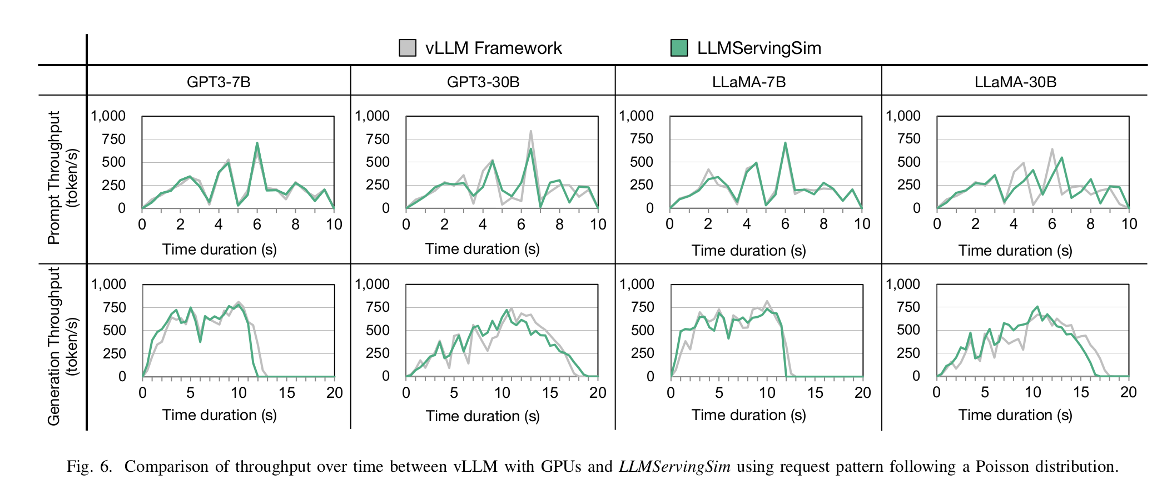
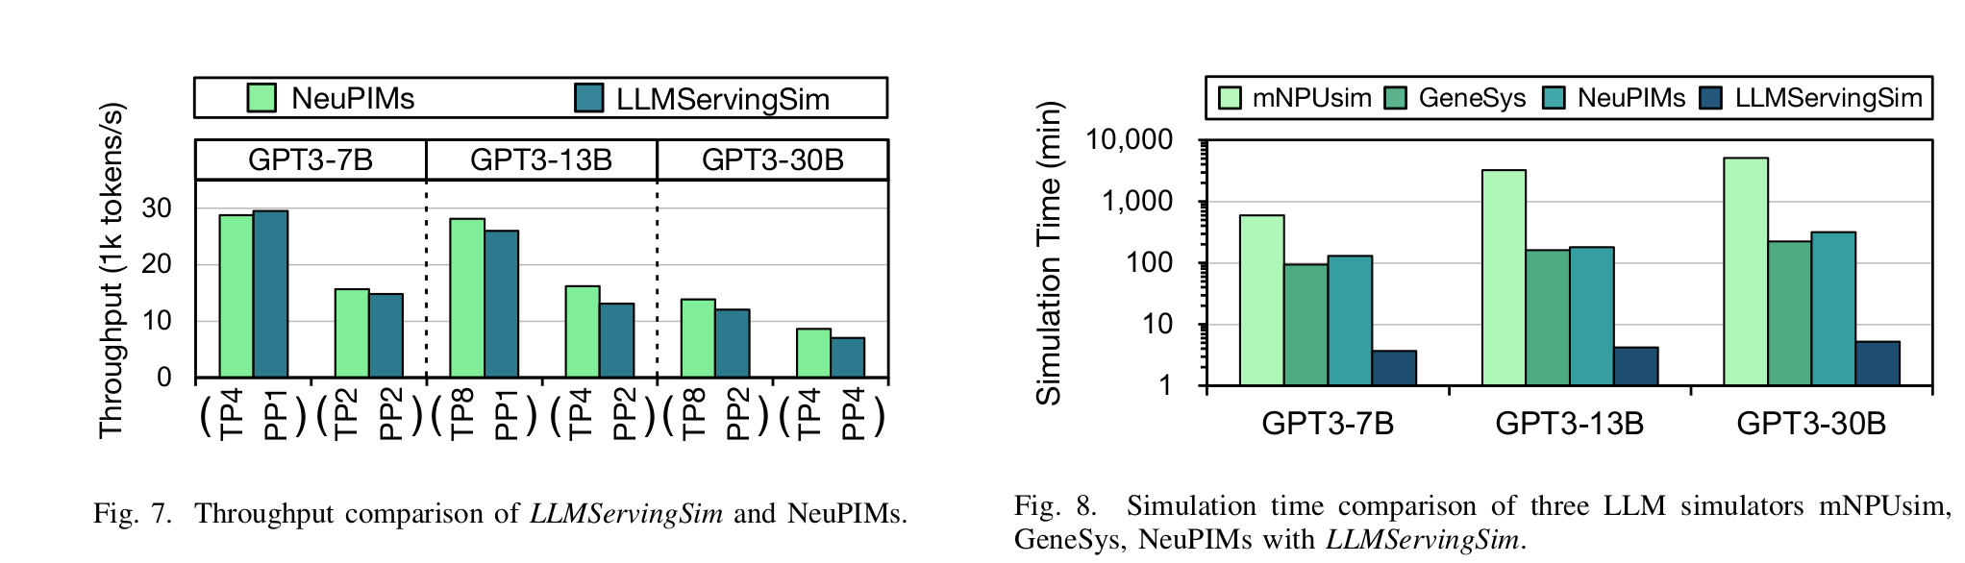
Evaluation

Slide 41
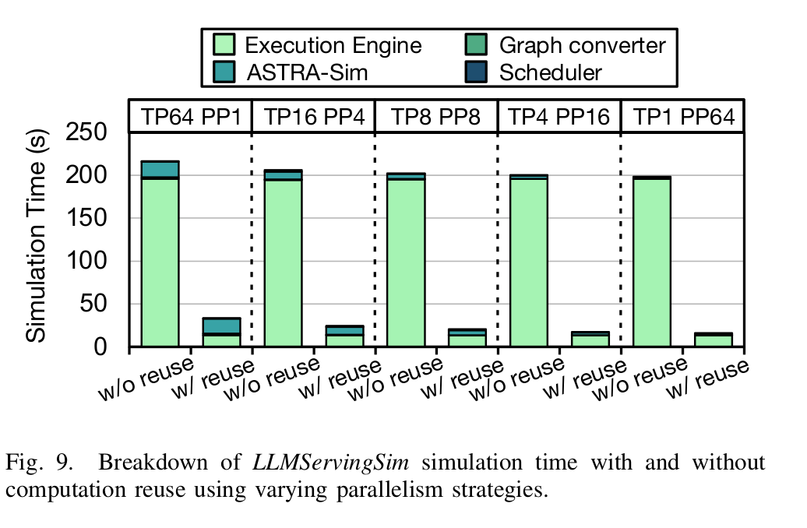
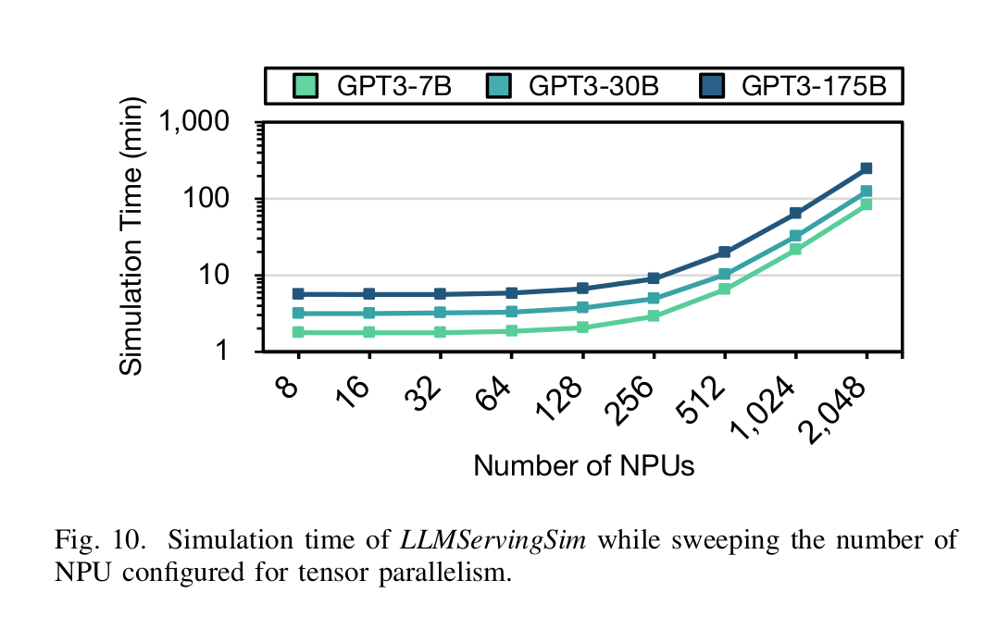
Evaluation

Slide 42
Future
Support for emerging LLM architectures: As new variant architectures like multi-modal models, mixture of experts (MoE), and retrieval-augmented generation (RAG) continue to evolve, LLMServingSim could be further enhanced by integrating specialized support for these architectures. Improved scheduling strategies and system configurations tailored to these models would ensure more accurate simulations.
Expanded integration with third-party hardware accelerators: While LLMServingSim already supports integration with various accelerators, future improvements could focus on expanding compatibility with more advanced computational storage solutions, such as SmartSSDs, and incorporating additional memory features like HDD and SSD storage to better simulate real-world systems.

Slide 43
Thanks

